Slide 1
Errors of Measurement
The basic tenet of measurement theory is the assumption that random error is present in all measurement
Obtained Score = True score + Error
Obtained score: An actual data value for a participant (e.g., anxiety scale score)
True score: The score that would be obtained with an infallible measure
Error: The error of measurement, caused by factors that distort measurement
In reality one does not know the true score and the error values, and only the observed score is known.
It is assumed that the observed score which is obtained when a measurement is taken is a combination of the true score and the error of measurement.

Slide 2
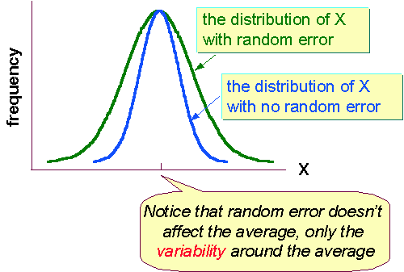
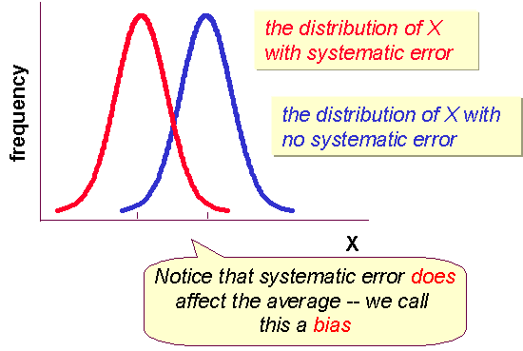
Random errors
Systematic error
Less likely to be measuring what should be measuring (measurement bias)
Refers to those factors that consistently or systematically affect the variable being measured.
Less likely to reproduce or repeat results
(variable or chance error)
Result of chance

Slide 3
Sources of Random Error
The manner in which a measure is scored or coded
Characteristics or state of the subject or respondent (for example, attention span, anxiety, or illness)
The administration or appraisal of measurements obtained (such as fatigue of observers, different emphasis placed on different words by interviewer, amount of heat or lighting in the room, or luck in the selection of answers by guessing).
Characteristics of the measure or tool (such as type of items employed or parameters of a mechanical device)
Sources of Systematic Error
Examples of systematic error associated with the respondent are chronic illness, test taking skills, a negative attitude toward completing questionnaires or taking tests, and a poor comprehension of language used in the tool or method
Characteristics of tools and methods that may systematically bias measurement are the inclusion of items that are irrelevant to the concept being measured and poor calibration of a measuring device
Error due to the measurement process per se, may result from observer or scorer bias (for example, the observer’s tendency to rate slim individuals higher than heavy individuals on items related to physical activity).

